Slide 1
How to design a Questionnaire

Slide 2
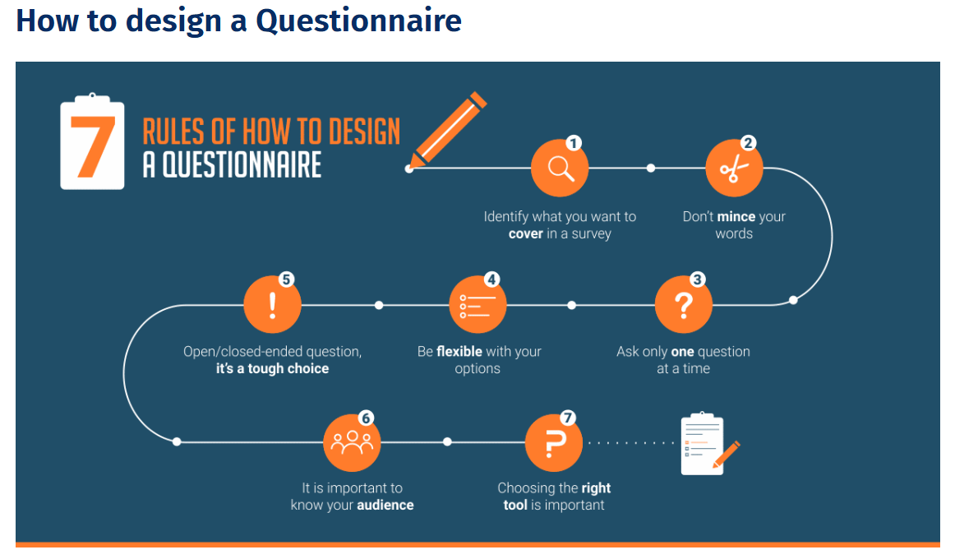

Slide 3
Questionnaire design is a multistep process that requires attention to detail at every step.
Researchers are always hoping that the responses received for a survey questionnaire yield useable data. If the questionnaire is too complicated, there is a fair chance that the respondent might get confused and will drop out or answer inaccurately.
As a survey creator, you may want to pre-test the survey by administering it to a focus group during development. You can try out a few different questionnaire designs to determine which resonates best with your target audience. Pre-testing is a good practice as the survey creator can comprehend the initial stages if there are any changes required in the survey.

Slide 4
Steps Involved in Questionnaire Design
1. Identify the scope of your research:
Think about what your questionnaire is going to include before you start designing the look of it. The clarity of the topic is of utmost importance as this is the primary step in creating the questionnaire. Once you are clear on the purpose of the questionnaire, you can begin the design process.
2. Keep it simple:
The words or phrases you use while writing the questionnaire must be easy to understand. If the questions are unclear, the respondents may simply choose any answer and skew the data you collect.

Slide 5
3. Ask only one question at a time:
At times, a researcher may be tempted to add two similar questions. This might seem like an excellent way to consolidate answers to related issues, but it can confuse your respondents or lead to inaccurate data. If any of your questions contain the word “and,” take another look. This question likely has two parts, which can affect the quality of your data.
4. Be flexible with your options:
While designing, the survey creator needs to be flexible in terms of “option choice” for the respondents. Sometimes the respondents may not necessarily want to choose from the answer options provided by the survey creator. An “other” option often helps keep respondents engaged in the survey.

Slide 6
5. The open-ended or closed-ended question is a tough choice:
The survey creator might end up in a situation where they need to make distinct choices between open or close-ended questions. The question type should be carefully chosen as it defines the tone and importance of asking the question in the first place.
If the questionnaire requires the respondents to elaborate on their thoughts, an open-ended question is the best choice. If the surveyor wants a specific response, then close-ended questions should be their primary choice. The key to asking closed-ended questions is to generate data that is easy to analyze and spot trends.

Slide 7
6. It is essential to know your audience:
A researcher should know their target audience. For example, if the target audience speaks mostly Spanish, sending the questionnaire in any other language would lower the response rate and accuracy of data. Something that may seem clear to you may be confusing to your respondents. Use simple language and terminology that your respondents will understand, and avoid technical jargon and industry-specific language that might confuse your respondents. For efficient market research, researchers need a representative sample collected using one of the many sampling techniques, such as a sample questionnaire. It is imperative to plan and define these target respondents based on the demographics required.
7. Choosing the right tool is essential:
Always save personal questions for last. Sensitive questions may cause respondents to drop off before completing. If these questions are at the end, the respondent has had time to become more comfortable with the interview and are more likely to answer personal or demographic questions.

